Slide 1
Basic Biological Concepts
Lecture 6 – Basic Biochemistry II
BIO 10 – Spring 2020

Slide 2
The metabolic process of harvesting the energy in glucose to make ATP is called cellular respiration
Cells harvest the energy from glucose slowly over many small steps
The energy harvested from 1 glucose can be used to build 36 ATP
Cellular respiration has 2 general steps:
Glycolysis
Oxidatitive phosphorylation

Slide 3
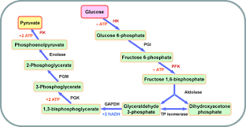
Glycolysis is the first step in cellular respiration
Some organisms only do this step and never continue on to oxidative phosphorylation (more on this later)
Properties of glycolysis:
Occurs in the cytosol
Breaks glucose in half resulting in 2 molecules of pyruvate
Yields 2 molecules of ATP
Does not require oxygen (O₂)
Glycolysis is a metabolic pathway

Slide 4
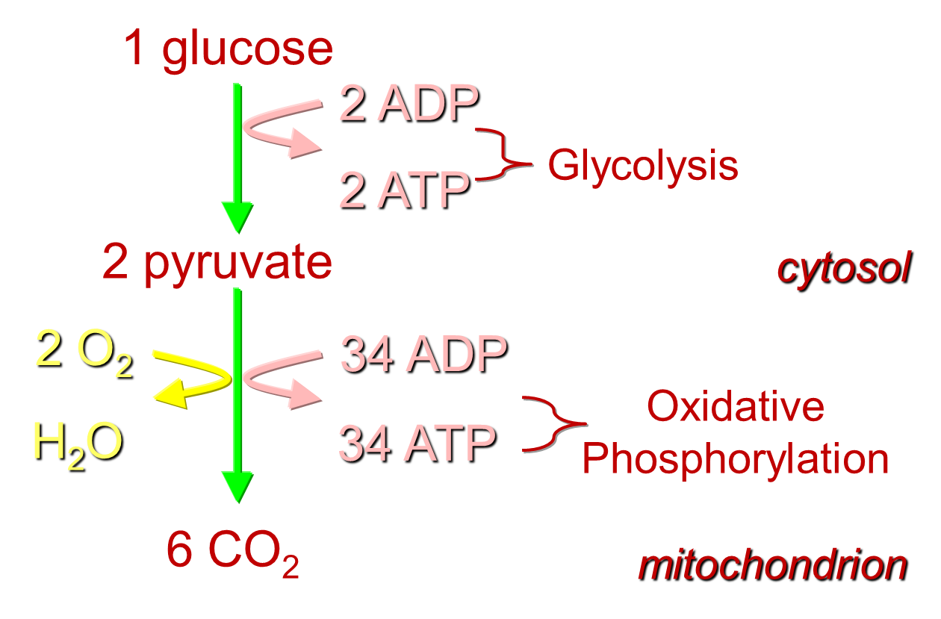
Properties of oxidative phosphorylation:
Occurs in the mitochondria
Breaks pyruvate down into CO₂
Yields 34 molecules of ATP
Requires oxygen (O₂)

Slide 5
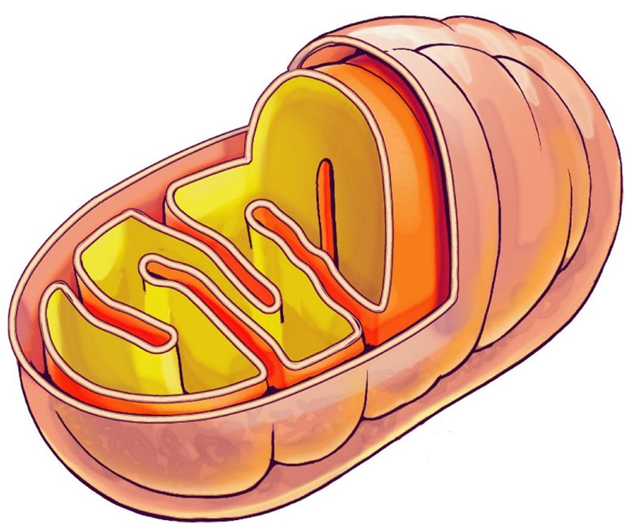
Oxidative phosphorylation uses three metabolic pathways:
The Krebs Cycle
The Electron Transport Chain (ETC)
ATP-Synthase
Mitochondria are organelles with two membranes:
The space between the membranes is called the inner-membrane space
The fluid inside the inner-membrane is called the matrix

Slide 6
The Krebs Cycle:
Breaks down 2 pyruvates to 6 CO₂ to produce 2 ATP
Creates high energy molecules NADH and FADH₂ to power electron transport chain.
Electron Transport Chain:
Requires oxygen (O2)
Hydrogen ion pumps powered by NADH and FADH2
Each NADH pumps enough H+ to form 3 ATP, each FADH2 forms 2 ATP
Creates a hydrogen ion (H+) gradient which powers ATP-Synthase
ATP-Synthase:
Powered by H+ ions flowing from inner-membrane space back into the matrix
Creates ATP from ADP + P

Slide 7
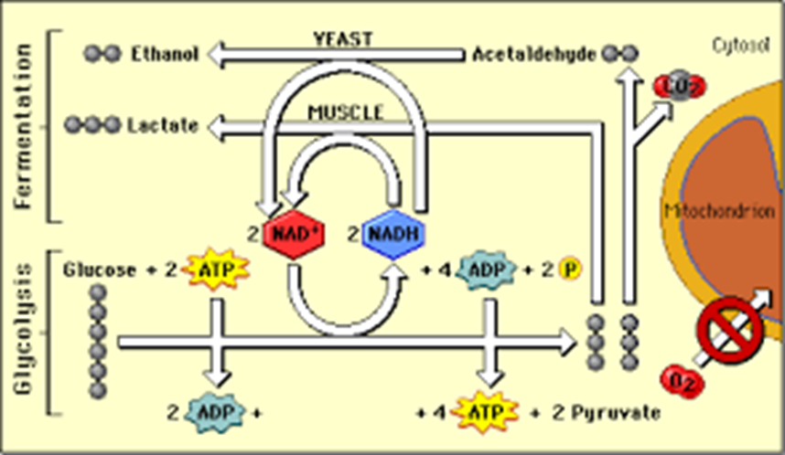
Anaerobic respiration is the breaking down of glucose without using oxygen
In animals, the pyruvate is broken down into lactate
Lactate build up in muscles causes pain (“Feel the burn”)
Lactate build-up in muscles only occurs if there isn’t enough O2 around to break down pyruvate through the process of oxidative phosphorylation

Slide 8
Organisms that rely on anaerobic respiration forgo oxidative phosphorylation and only carry out glycolysis
In some bacteria and yeast, the pyruvate is broken down into ethanol (alcohol) and CO2
We use these organisms to make beer and wine, as well as to make bread rise (with CO2 bubbles)

Slide 9
Fermentation is a metabolic process that extracts energy from carbohydrates in the absence of respiration.
The science of fermentation is known as zymology.
In many microorganisms, fermentation is the primary means of producing adenosine triphosphate (ATP) by the degradation of organic nutrients anaerobically.
Fermentation also occurs within the gastrointestinal tracts of all animals, including humans
Humans have used fermentation to produce foodstuffs and beverages since the Neolithic age.
Fermentation is used for food preservation in a process that produces lactic acid found in such sour foods as pickled cucumbers, kimchi, and yogurt
As well as for producing alcoholic beverages such as wine and beer.

Slide 10
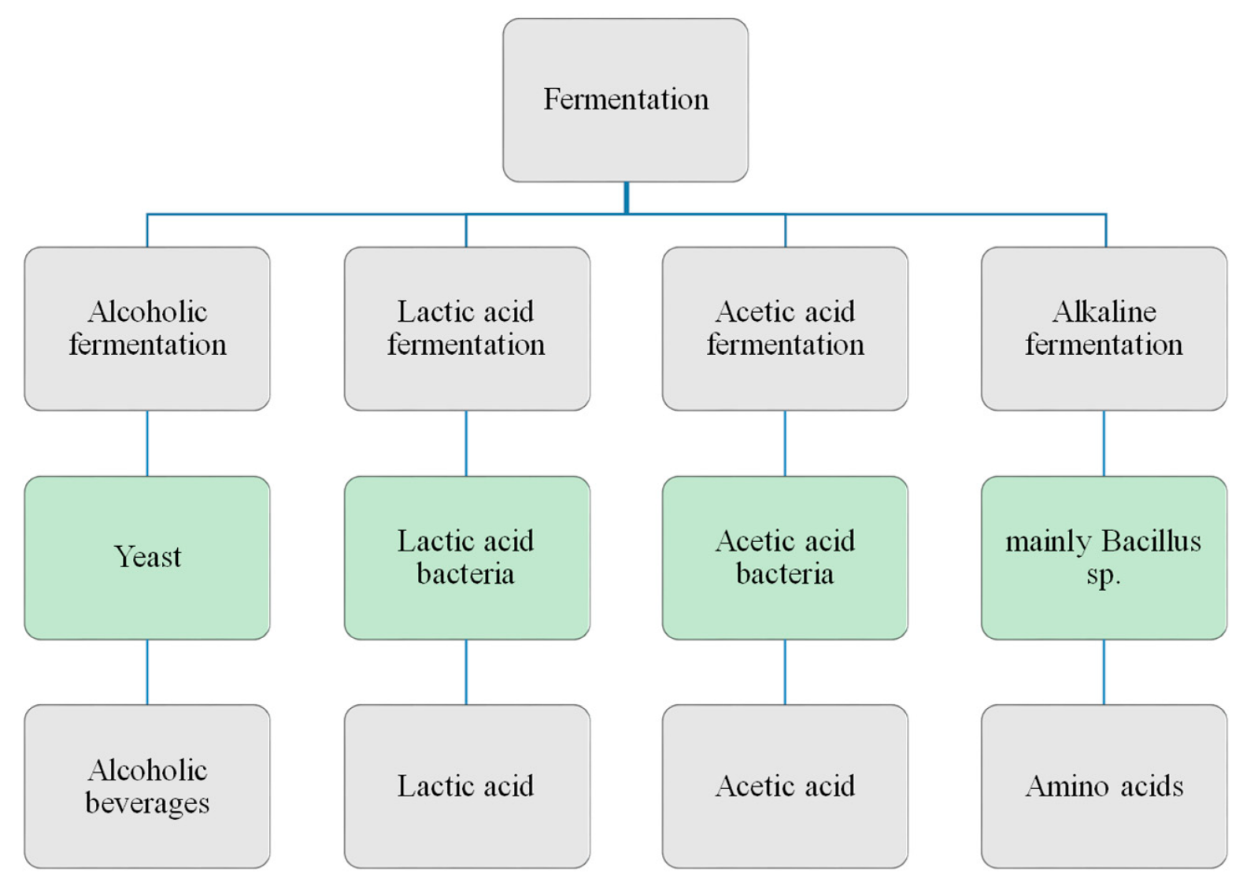
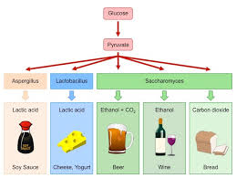

Slide 11
Now that we know something about the biomolecules let’s go back and look at Earth’s biosphere….
We’ll look at Four Key Nutrient Cycles:
Water Cycle
Energy Cycle
Nitrogen Cycle
Carbon Cycle

Slide 12
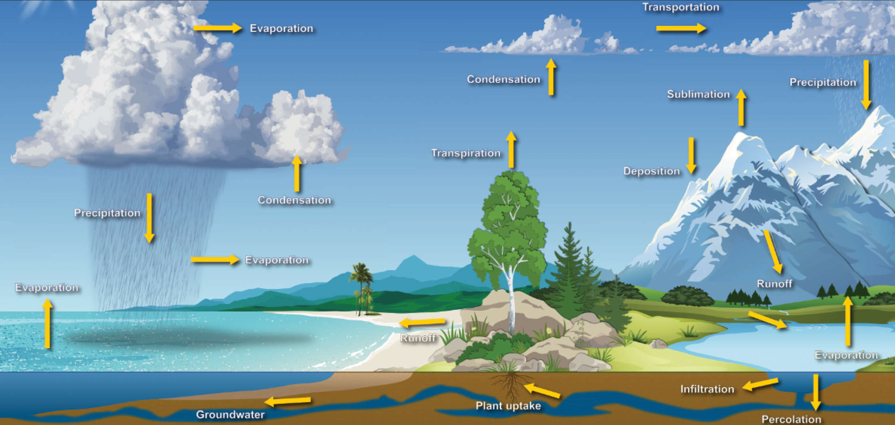
The Water Cycle is Essential for All Life
🡨 Ice 🡨🡪 Fresh water 🡨🡪 Sea water 🡨🡪 Water vapor 🡪

Slide 13
Human impacts on the water cycle
Climate change and pollution are affecting where, when, and how much water is available.
Extreme weather events such as droughts and heavy precipitation, which are expected to increase as climate changes, can impact water resources.
The net effect: A greater percentage of the Earth’s water ends up in the salty sea
A lack of adequate fresh water supplies, flooding, or degraded water quality can affect:
Human, agricultural and natural ecosystem health
Where and how organisms can survive
The economy, transportation and national security
Energy production and use

Slide 14
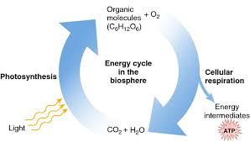
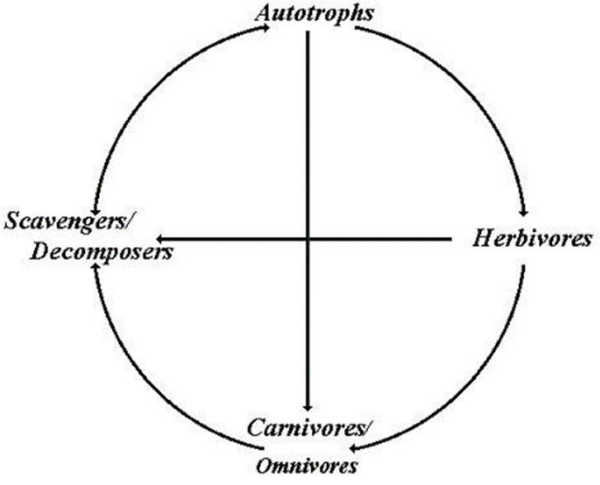
The Energy Cycle
Life’s processes (i.e. reproduction, growth, etc.) require that a constant supply of energy and nutrients be introduced into the body.
The sun begins the process through organisms like plants and other photosynthetic producers.
The higher organisms eat the lower organisms, break down their matter and rearrange the molecules to make their own matter.
When any organism dies, the remains are broken down and put back into the cycle as small organic and inorganic molecules.

Slide 15
A food web describes all of the organisms in an area and connects those that are eaten to those that eat them.
Consumers (heterotrophs) eat matter from organisms lower in the food web. The different categories of consumers include: herbivores (plants), carnivores (meat) and omnivores (both).
There are several levels of consumers. The order depends on how many organisms have been eaten before.
1st order consumers eat only plants
2nd order consumers eat something that has eaten plants
3rd order consumers eat 2nd order consumers, and so on
At the “bottom” of the food chain are the scavengers and decomposers. They break down dead matter to return it to the soil for use by producers.
Scavengers generally eat dead meat
Decomposers will eat anything that has died.

Slide 16
Human impacts on the energy cycle:
Atmospheric pollution blocks the energy producing rays of the sun
Ozone layer disruption by greenhouse gasses allows more harmful rays to make it through
Forest degradation reduces photosynthetic capacity and carbon sequestration
Excessive population uses up arable land for growing crops
Excessive population and species reduction changes functioning food webs
This list can be very long and very depressing!!

Slide 17
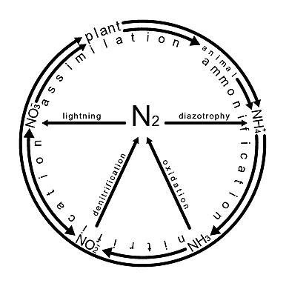
The Nitrogen Cycle is essential to all life.
Both amino acids and nucleic acids are dependent on nitrogen in their structure.
The majority of Earth's atmosphere (78%) is nitrogen gas (N₂), making it the largest source of nitrogen.
However, N₂ has limited availability for biological use, leading to a scarcity of usable nitrogen in many types of ecosystems.
Important processes in the nitrogen cycle include fixation, nitrification and denitrification.

Slide 18
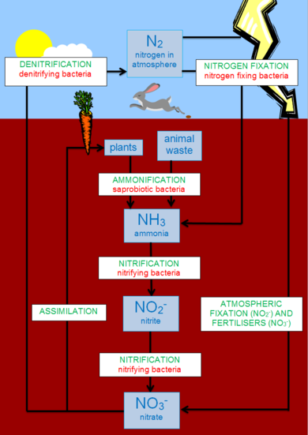
The nitrogen cycle is the biogeochemical cycle by which nitrogen is converted into multiple chemical forms as it circulates among atmosphere, terrestrial, and marine ecosystems.
The conversion of nitrogen can be carried out through both biological and physical processes.

Slide 19
Human impacts on the nitrogen cycle:
The nitrogen cycle is of particular interest to ecologists because nitrogen availability can affect the rate of key ecosystem processes, including primary production and decomposition.
Human activities such as fossil fuel combustion, use of artificial nitrogen fertilizers, and release of nitrogen in wastewater have dramatically altered the global nitrogen cycle.
Human modification of the global nitrogen cycle can negatively affect the natural environment system and also human health.

Slide 20
The Carbon Cycle
The carbon cycle is the biogeochemical cycle by which carbon is exchanged among the biosphere, geosphere, hydrosphere, and atmosphere of the Earth.
Carbon is the main component of biological compounds as well as a major component of many minerals such as limestone.
It is the series of processes by which carbon compounds are interconverted in the environment
The incorporation of carbon dioxide into living tissue by photosynthesis
Its return to the atmosphere through respiration and the decay of dead organisms

Slide 21
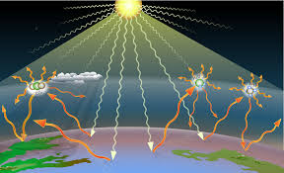
Human impacts on the carbon cycle.
The Greenhouse Effect
Atmospheric gasses trap the energy producing rays of the sun
Ozone layer disruption by greenhouse gasses allows more harmful rays to make it through
Forest degradation reduces photosynthetic capacity and carbon sequestration
Excessive population uses up arable land for growing crops
Excessive population and species reduction changes functioning food webs
This list can be very long and very depressing!!
Greenh

